Slide 1


Sales Analysis

Slide 2
Problem Statement
As competition heats up, managing our sales effectively is more important than ever. Right now, our sales data is all over the place, which makes it tough to get a clear picture and act quickly. We need a simple, all-in-one dashboard to bring everything together and help us stay ahead.

Slide 3
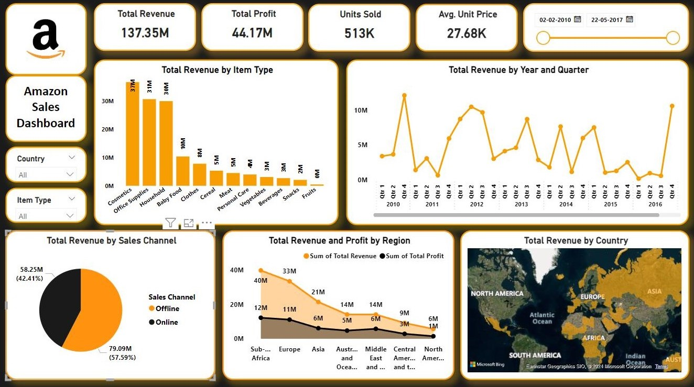

Slide 4
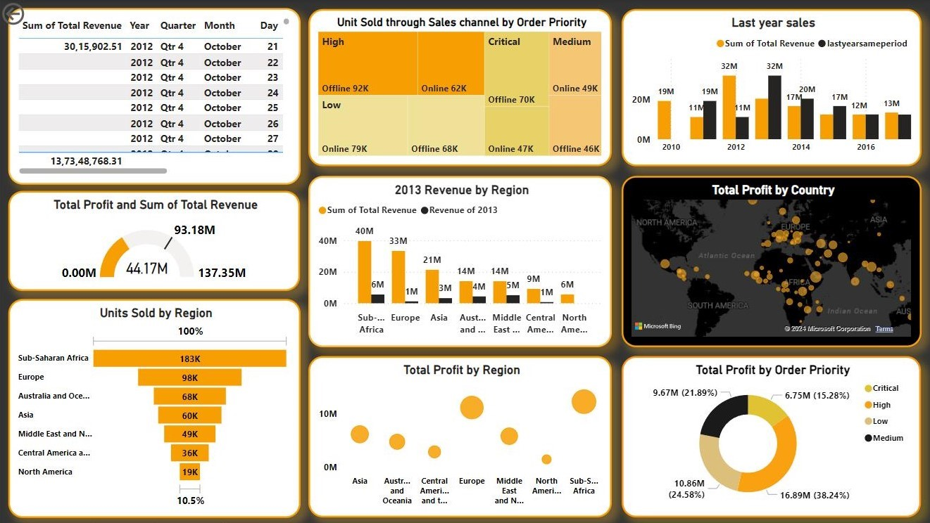

Slide 5


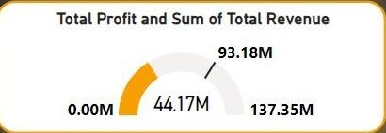
KEY
PERFORMANCE INDICATOR
These are the key performance indicator(KPI)
Total Revenue is 137.35 million and Total Profit is 44.17 million.
Profit-to Revenue Ratio is 0.322.
These ratios indicate that organization is operating with a profit margin of around 32.2%, which is quite healthy.

Slide 6
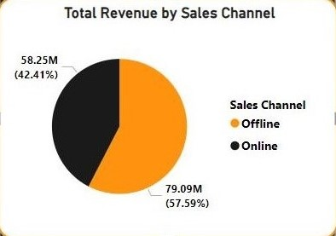
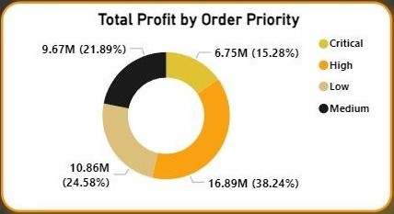
This chart shows Total Revenue by Sales Channel.
Here 2 categories are shown Online and Offline.
From the diagram it is easy to understand that offline sales is more than online sales.
SALES
CHANNELS
This chart shows Total Profit by Order Priority.
We can see 4 categories in this graph.
Through high order priority we can have more profit.
Profit is less for critical order priority.

Slide 7
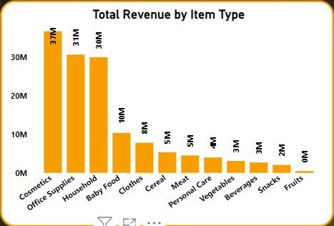
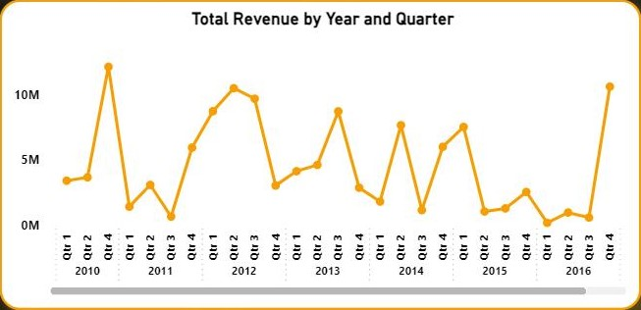
This graph shows Total Revenue by Item Type
Here cosmetics have higher demand, revenue from cosmetics is 37 million.
Least or no revenue is generated from fruits.
REVENUE
This graph shows Total Revenue by Year and Quarter.
Year ranges from 2010 to 2016 and maximum revenue generated in the year of 2010 between 3rd and 4th quarter.
Lowest revenue generated in 2016 in 1st quarter.

Slide 8
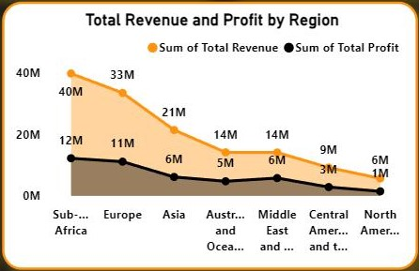
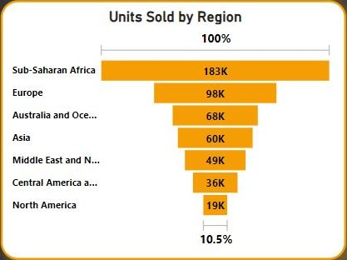
Total Revenue & Profit by Region
From the diagram we can understand that Sub-Saharan Africa has highest Revenue and profit, And least for North America.
REGION
Units Sold by Region
Sub-Saharan Africa has the highest units sold.
Least units sold by North American region.

Slide 9

Insights and Recommendations
1. Boost Customer Experience
Make Satisfaction a Top Priority: Focus on initiatives that truly enhance how customers feel about their experience with us.
Key Areas to Improve:-
Speed Up Deliveries
Simplify Returns
Personalize Recommendations
2. Enhance Operational Efficiency
Invest in the Latest Technology: Adopt new technologies that help automate tasks and streamline operations.
Refine Logistics: Improve our logistics to cut down on delays and lower costs.
Cut Costs: Look for ways to trim unnecessary expenses and make our operations more cost-effective.
3. Explore New Revenue Opportunities
Expand Product Range: Introduce new product lines to attract a wider audience and reduce our dependence on current offerings.
Consider New Business Ventures: Investigate potential new business areas that could provide additional revenue streams and drive long-term growth.

Slide 10


Actionable Insights
Understand Performance:
Get a clear picture of how our business is doing and what customers want.
Make Smart Decisions:
Use this understanding to make decisions that will help us succeed.
Continuous Improvement
Keep Tracking:
Regularly check and analyze our data to stay on top of trends and needs.
Be Flexible:
Adjust our plans based on new information and opportunities to stay competitive.
Strategic Alignment
Fit with Business Goals:
Make sure our actions match our overall business strategy.
Enhance Results:
Align our efforts to maximize their impact and drive long-term success.
CONCLUSION

